Slide 1
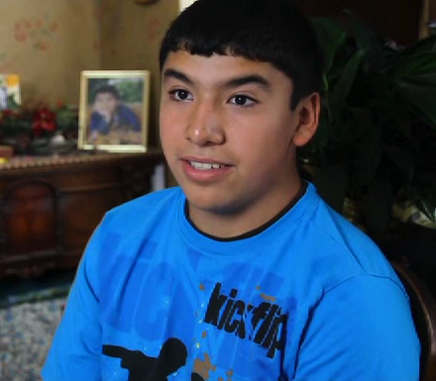
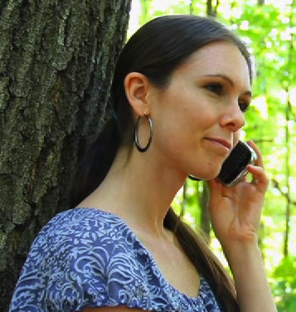

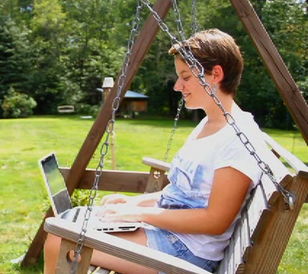
www.vlacs.org
facebook.com/vlacs
Twitter: virtuallrnacad

Slide 2
Who Are We?
New Hampshire's first statewide on-line virtual public school. VLACS goal is to use the latest internet technologies to provide our students with any time, any where access to a rigorous, personalized education.
Tuition-free for all students residing in NH
We accept both full-time and part-time students
An approved New Hampshire public school
Courses taught by New Hampshire certified instructors
Full range of course offerings grades 6-14
Dual credit options through SNHU and CCSNH
Rolling Enrollment

Slide 3


Enrollments
January 2008
700
June 30, 2012
15,500
Enrollments in ½ credit increments

Slide 4
Students
Public 65%
Homeschooled 23%
VLACS FT 5%
Private 3%
Drop-out 3%
Charter 1%

Slide 5
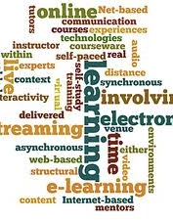
Why VLACS?
Acceleration
Credit Recovery
Scheduling conflicts
Expanded Course offerings
Travel, Sports, Performing Arts
Home School
Work
Medical
Teens in crisis
Dual Credit Opportunities
Notes:
Gymnast and/or lyme disease

Slide 6
Student Relationships
Welcome Call
Weekly Contact
Communication Tools
Monthly Phone Calls
Student Pace Set Collaboratively
Compliment, Coach and Encourage Model
70 Hours of Online Academic Helpdesk Support
“…how caring my teacher is with all of my questions and comments. She always helped me and responded very quickly when ever I had a problem.” - VLACS student
Notes:
Start with an overview of why this is so important:
- Leads to student success

Slide 7
Local School Relationships
Partner with VLACS
24/7 Access to Student Information System
Access to VLACS Support
  Guidance, Administration, Technical Help Desk
Modify Scheduling/Programming
Access to VLACS Competencies and ELOs
“The ability for student to make-up specific competencies has made credit recovery possible for some students that might not have made it before.” - School Official

Slide 8

Flexibility
Enrollment
Student Pace & Progress
Curriculum
“It gives me the flexibility I need with the baby and work.” -VLACS Student
Notes:
Graduating early and student traveling doing community service

Slide 9
How are schools partnering with VLACS?
Merrimack Valley Competency Recovery
Souhegan Math Acceleration
ConVal Blended Learning Labs
Summer School Competency Recovery
North Country Experiential Learning Opportunities
Goffstown Alternative Program
Pittsburgh World Language Offerings

Slide 10
Thank you
Scott Prescott – Director of Instruction
sprescott@vlacs.org
603-778-2500 Ext. 846

